Slide 1
Lecture 2
Non Deterministic Finite Automata
Asma Sanam Larik

Slide 2
Nondeterminism
Nondeterminism is a useful concept
In our automata every step of computation follows in a unique way from the preceding step
Given a state and the next input symbol we know exactly what will be the next state of machine
That is, it can be determined
In nondeterministic machines several choices may exist for the next state at any point
0, 1 0, 1
1
0, ϵ
1
q₁
q₂
q₃
q₄

Slide 3
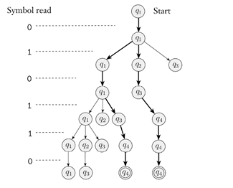
Lets run 010110 on the NFA

Slide 4
Nondeterministic Finite Automata
Nondeterministic Finite Automata
A nondeterministic finite automata is a 5-tuple (Q, Σ, δ, q₀, F ), where
Q is a finite set of states,
Σ is a finite alphabet,
δ : Q × Σ_{ϵ} → P(Q) is the transition function,
q₀ ∈ Q is the start state, and
F ⊆ Q is the set of accept states.

Slide 5
Example NFA
0, 1
0, 1
1
0, ϵ
1
q₁
q₂
q₃
q₄
1. Q = {q₁, q₂, q₃, q₄}
2. Σ = {0, 1}
3.Tansition function δ:
q₁ q₂ q₃ q₄
0 1
{q₁} {q₁, q₂} ∅
{q₃} ∅ {q₃}
∅
∅
ϵ
∅
{q₄}
{q₄}
{q₄}
4. q₁ is the start state, and 5. F = {q₄}
19

Slide 6
Let N = (Q, Σ, δ, q₀, F ) be an NFA
w = y₁y₂ · · · y_{m} over some alphabet Σ_{ϵ}
r₀, r₁, . . . , r_{m} exists in Q such that:
1. r₀ = q₀,
2. r_{i+1} ∈ δ(r_{i}, y_{i+1}), for i = 0, . . . , m − 1, and
3. r_{m} ∈ F
Then, we say N accepts w

Slide 7
Difference between DFA and NFA
More than one transition from same symbol is possible
Empty transitions are allowed
Not all transitions need to be drawn

Slide 8
Determinism and Nondeterminism
Theorem 2
Every nondeterministic finite automaton has an equivalent
deterministic finite automaton.
If we could show for a language A recognized by an NFA can also be recognized by a DFA then we are done with the proof.
So, lets convert an NFA into a DFA.

Slide 9
Proof: assuming no ϵ transitions
Proof.
N = (Q, Σ, δ, q₀, F ) be the NFA recognizing some language A
DFA M = (Q′, Σ, δ′, q₀′ , F′) recognizing A
Q′ = P(Q)
For R ∈ Q′ and a ∈ Σ, let
δ′(R, a) = {q ∈ Q : q ∈ δ(r, a) for some r∈ R}
or
[
′
δ (R, a) = δ(r, a).
r∈R
q₀′ = {q₀}
F′ = {R ∈ Q′ : R contains an accept state of N}

Slide 10
Proof with ϵ transitions
Proof.
For any state R of M , we define E(R) to be the collection of states that can be reached from members of R by going only along ϵ arrows including the members of R themselves,for
R ⊆ Q
E(R) = {q : q can be reached from R traversing ϵ arrows}
The new transition function can be written as:
δ′(R, a) = {q ∈ Q : q ∈ E(δ(r, a)) for some r ∈ R}.
The new start state of M would be E({q₀})

Slide 11
Corollary 3
A language is regular if and only if some nondeterministic finite
automaton recognizes it.

Slide 12
Example: Convert from NFA to DFA
1
a
b
ϵ
a
2
3
a, b

Slide 13
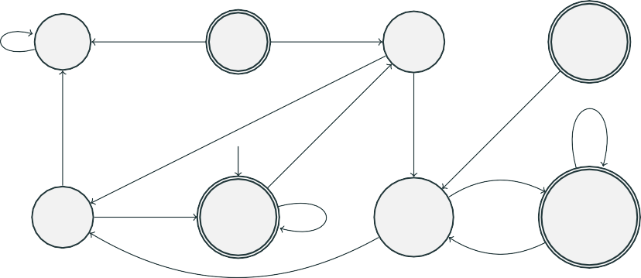
Example: NFA to DFA
a
b
a, b
∅
{1}
b
{2}
{1, 2}
a
b
a, b
b
a
a
{3}
{1, 3}
a {2, 3}
{1, 2, 3}
a
b
b

